Slide 1

Graphics using C++
Make the world animations

Slide 2
Introduction to C++
C++, as we all know is an extension to C language and was developed by Bjarne stroustrup at bell labs. C++ is an intermediate level language, as it comprises a confirmation of both high level and low level language features. C++ is a statically typed, free form, multiparadigm, compiled general-purpose language.
C++ is an Object Oriented Programming language but is not purely Object Oriented. Its features like Friend and Virtual, violate some of the very important OOPS features, rendering this language unworthy of being called completely Object Oriented. Its a middle level language.

Slide 3
Benefits of C++ over C Language
The major difference being OOPS concept, C++ is an object oriented language whereas C language is a procedural language. Apart form this there are many other features of C++ which gives this language an upper hand on C laguage.
Following features of C++ makes it a stronger language than C,
There is Stronger Type Checking in C++.
All the OOPS features in C++ like Abstraction, Encapsulation, Inheritance etc makes it more worthy and useful for programmers.
C++ supports and allows user defined operators (i.e Operator Overloading) and function overloading is also supported in it.
Exception Handling is there in C++.
The Concept of Virtual functions and also Constructors and Destructors for Objects.
Inline Functions in C++ instead of Macros in C language. Inline functions make complete function body act like Macro, safely.
Variables can be declared anywhere in the program in C++, but must be declared before they are used.

Slide 4
Data Types in C++
Basic Built in types
char for character storage ( 1 byte )
int for integral number ( 2 bytes )
float single precision floating point ( 4 bytes )
double double precision floating point numbers ( 8 bytes )
void Without any Value
Modifiers
long
short
signed
unsigned

Slide 5
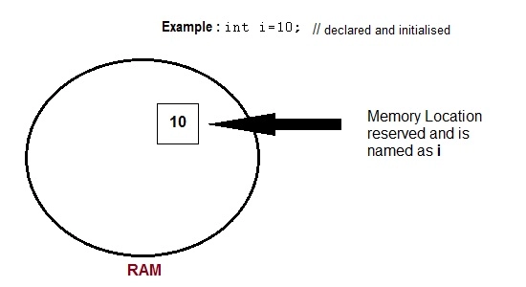
Variables
Variable are used in C++, where we need storage for any value, which will change in program. Variable can be declared in multiple ways each with different memory requirements and functioning.

Slide 6
String in C++
A string is a sequence of character
C++ does not support built-in string type
Syntax: char string[] = “Hello C++”;
The one-dimensional array of characters are called strings.
This is terminated by a null character \0.

Slide 7
Manipulating string
strcpy(str1, str2): Copies string str2 into string str1.
strcat(str1, str2): Concatenates string str2 onto the end of string str1.
strlen(str1): Returns the length of string str1.
strcmp(str1, str2): Returns 0 if str1 and str2 are the same; less than 0 if str1<str2; greater than 0 if str1>str2.
strchr(str1, ch): Returns a pointer to the first occurrence of character ch in string str1.
strstr(str1, str2): Returns a pointer to the first occurrence of string str2 in string str1.

Slide 8
Important functions supported in string
append(): This function appends a part of a string to another string
assign():This function assigns a partial string
at(): This function obtains the character stored at a specified location
begin(): This function returns a reference to the start of the string
capacity(): This function gives the total element that can be stored
compare(): This function compares a string against the invoking string
empty(): This function returns true if the string is empty
end(): This function returns a reference to the end of the string
erase(): This function removes character as specified
find(): This function searches for the occurrence of a specified substring
length(): It gives the size of a string or the number of elements of a string
swap(): This function swaps the given string with the invoking one

Slide 9
Scope of Variables
Global Variables
Local variables
Static -These variables holds their value between function calls.
Final - Once initialized, its value cant be changed.
const

Slide 10
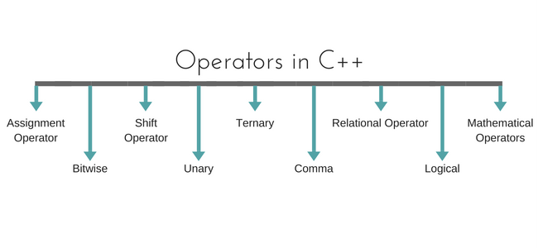
Operators in C++
Operators are special type of functions, that takes one or more arguments and produces a new value. For example : addition (+), substraction (-), multiplication (*) etc, are all operators. Operators are used to perform various operations on variables and constants.

Slide 11
I/O Services
The C++ standard libraries provide an extensive set of input/output capabilities.
C++ I/O occurs in streams, which are sequences of bytes.
Input streams
If bytes flow from a device like a keyboard, a disk drive, or a network connection etc. to main memory, this is called input operation. Eg: cin
Output operation
if bytes flow from main memory to a device like a display screen, a printer, a disk drive, or a network connection, etc., this is called output operation. Eg: cout,cerr,clog
Header files
Using Namespace std

Slide 12
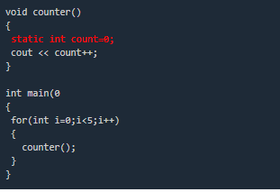
Static Keyword
Static is a keyword in C++ used to give special characteristics to an element. Static elements are allocated storage only once in a program lifetime in static storage area. And they have a scope till the program lifetime. Static Keyword can be used with following,
Static variable in functions
Static Class Objects
Static member Variable in class
Static Methods in class.

Slide 13
Const Keyword
Constant is something that doesn't change. In C and C++ we use the keyword const to make program elements constant. const keyword can be used in many contexts in a C++ program.
It can be used with:
Variables
Pointers
Function arguments and return types
Class Data members
Class Member functions
Objects

Slide 14
Conditional and Looping
IF, Else if, Nested if
Switch
While
Do while
For

Slide 15
C++ Arrays
the array, which stores a fixed-size sequential collection of elements of the same type.
Declaring Arrays
datatype arrayName [ arraySize ];
Initializing Arrays
Int array[5] ={2,4,6,8,10};
Accessing Array Elements
Int array_va=array[2];

Slide 16
Functions
A function is a group of statements that together perform a task.
Function Declarations
Function definition
Calling a Function
Function Arguments
Default Values for Parameters
Call by value
Call by reference

Slide 17
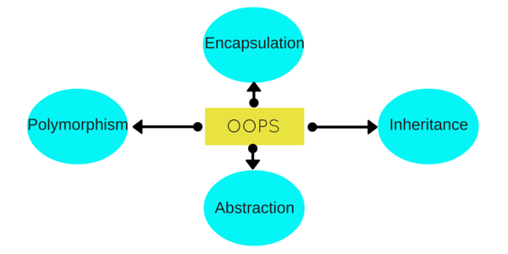
Object Oriented Programming
Object Oriented programming is a programming style that is associated with the concept of Class, Objects and various other concepts revolving around these two, like Inheritance, Polymorphism, Abstraction, Encapsulation etc.

Slide 18
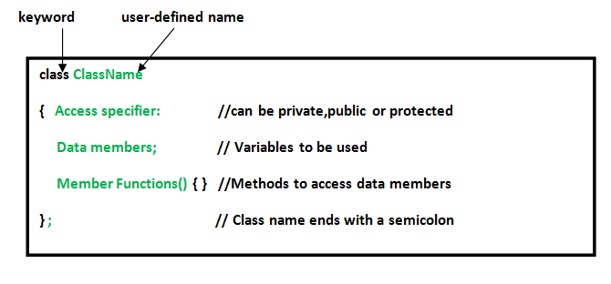
Class
In object-oriented programming, a class is an extensible program-code-template for creating objects, providing initial values for state and implementations of behavior.

Slide 19
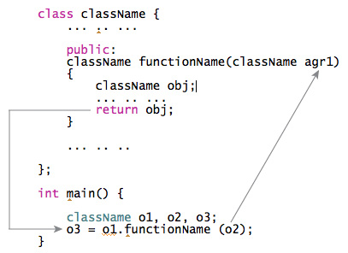
Objects
Objects are the basic unit of OOP. They are instances of class, which have data members and uses various member functions to perform tasks.

Slide 20

Abstraction
Abstraction refers to showing only the essential features of the application and hiding the details.

Slide 21
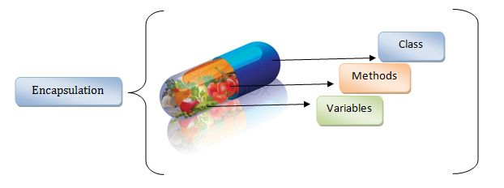
Encapsulation
Encapsulation is all about binding the data variables and functions together in class.

Slide 22
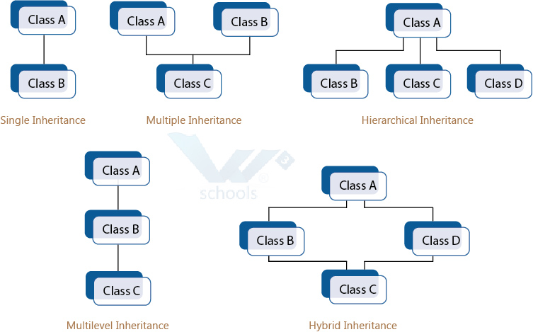
Inheritance
Derive a new class from the existing class. The derived class inherits the features of the base class (existing class).

Slide 23
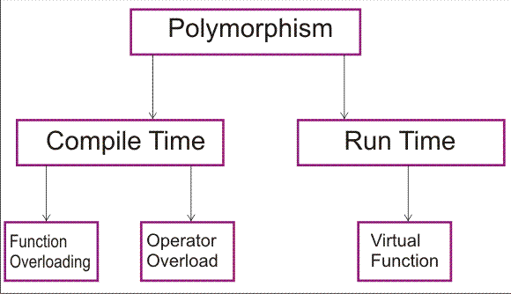
Polymorphism
Create functions with same name but different arguments, which will perform different actions. That means, functions with same name, but functioning in different ways.

Slide 24
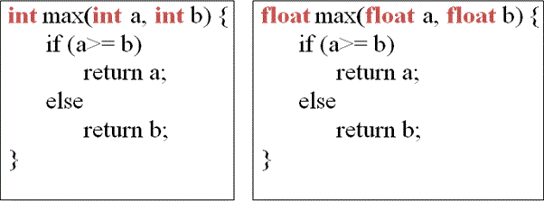
Function overloading
Two or more functions having same name but different argument(s) are known as overloaded functions.

Slide 25
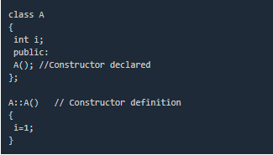
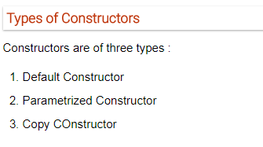
Constructors
Constructors are special class functions which performs initialization of every object. The Compiler calls the Constructor whenever an object is created. Constructors iitialize values to object members after storage is allocated to the object.

Slide 26
Destructors
Destructor is a special class function which destroys the object as soon as the scope of object ends. The destructor is called automatically by the compiler when the object goes out of scope.
The syntax for destructor is same as that for the constructor, the class name is used for the name of destructor, with a tilde ~ sign as prefix to it.
class A
{
public:
~A();
};
Destructors will never have any arguments.

Slide 27
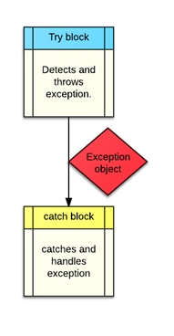
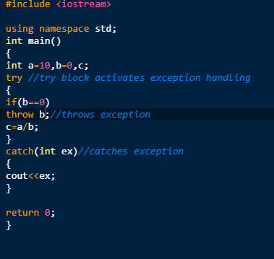
Exception Handling
Exception handling is a feature of OOP, to handle unresolved exceptions or errors produced at runtime.

Slide 28
Multithreading in C++
Multithreading means two or more threads runs concurrently and each thread handles different tasks .
Example : FB When you login to Facebook page you can see live videos, you can comment or hit a like simultaneously. While you are commenting it will check for your spelling mistakes.
There are various uses of multithreading are:
Better resource utilization.
Simpler program design.
More responsive programs.
Thread Thread is generally referred as light weight process. Each thread executes different parts of a program. Each thread shares memory, file descriptors and other system resources.

Slide 29
Creating Threads
pthread_create() - It creates a new thread.
Syntax: pthread_create(threadID,attr,start_routine,arg)
ThreadID - unique identifier for each thread. ThreadID compared with other thread using pthread_equal().
attr - Attribute object that may be used to set thread attributes. It controls interaction of thread with rest of the program.
start_routine - The C++ routine that the thread will execute once it is created.
arg - Single argument must be passed by reference as a pointer cast of type void. If no argument is to be passed, null can be used.
pthread_exit() - It is used to terminate a thread.

Slide 30
#include <iostream>
#include <iostream>
#include <cstdlib>
#include <pthread.h>
using namespace std;
#define NUM_THREADS 5
void *PrintHello(void *threadid)
{
long tid;
tid = (long)threadid;
cout << "Hello World! Thread ID, " << tid << endl;
pthread_exit(NULL);
}
int main () {
pthread_t threads[NUM_THREADS];
int rc; int i;
for( i = 0; i < NUM_THREADS; i++ ) {
cout << "main() : creating thread, " << i << endl;
rc = pthread_create(&threads[i], NULL, PrintHello, (void *)i);
if (rc) {
cout << "Error:unable to create thread," << rc << endl;
exit(-1);
} }
pthread_exit(NULL);
}

Slide 31


